Slide 1

Sampling

Slide 2
Sampling
Population vs. sample
Sampling is used for more than just survey research
  All forms of research
Probability vs. nonprobability sampling
Quantitative research – probability
Qualitative research – nonprobability

Slide 3
Probability sampling – representativeness is most important
Does the sample represent the population as a whole?
Techniques of probability sampling get at different ways of ensuring representativeness
Simple random sampling – randomly pick individuals to include in the sample
  All individuals must have an equal chance of being selected.
  As sample size increases, sample becomes more and more representative of population.
  Sampling is generally without replacement
  Problem: can be very costly if population is large. Choices come from a list; who makes the list?

Slide 4
Systematic random sampling – samples according to a rule
  E.g., every fifth person is chosen
  Problems: same as simple random. Rule must not lead to bias.
Stratified sampling – break the sample into various subgroups or strata and sample from them.
  Must have good knowledge of strata
Cluster sampling - the subjects are selected in groups or clusters rather than randomly
  E.g., interviewing McDonald’s employees
  Clusters would be every employee at a particular store.

Slide 5
One-stage cluster sampling – sample all members of the cluster
Two-stage cluster sampling – random sampling within the clusters
Weighting of clusters: probability proportionate to size (PPS) sampling
  Not all clusters are the same size.
  Can weight the clusters to equate the difference.
  Can weight the chances of a cluster being selected
Effectiveness of cluster sampling
  Much more efficient; less costly
  Not quite as effective as random sampling

Slide 6
Multi-stage sampling – random sampling in stages.
E.g., voting in Oklahoma
Stage one – randomly choose 10 counties
Stage two – randomly choose voters within those counties.
Can have many stages.
Especially useful if the population is very large.

Slide 7
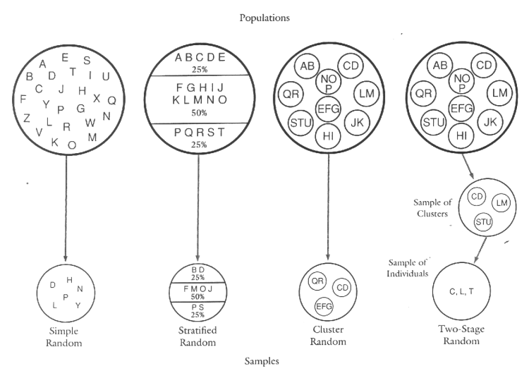

Slide 8
Nonprobability sampling
Qualitative researchers are not as concerned about representativeness
  Relevance to the research topic
  Importance of context
Sample size does not have to be determined in advance.
  Selection of cases gradually over time
Important: many statistics assume random sampling

Slide 9
Types of nonprobability sampling
Convenience sampling (haphazard, accidental) – sample whoever is available.
Used by both quantitative and qualitative researchers
Problems
  no representativeness
  It is haphazard, can be very biased
  Not random (avoid using word)

Slide 10
Quota sampling - quotas for certain types of people or organizations are selected as the sample
  Interviewers are required to find cases with particular characteristics
  E.g., certain number of Hispanics, teenagers, etc.
  Like nonrandom version of stratified
Pros – better than convenience; introduce some diversity
Cons –
  Theoretical quotas must be accurate to be useful.
  It is nonrandom sampling

Slide 11
Purposive sampling - Use judgment and deliberate effort to pick individuals who meet a specific criteria.
Especially good for exploratory or field research.
Appropriate for at least 3 situations.
1. select cases that are especially informative.
  E.g., college coaches and championships
2. desired population for the study is rare or very difficult to locate.
  E.g., prostitutes
3. case studies analysis – find important individuals and study them in depth.

Slide 12
Snowball sampling – an individual or group of individuals are sampled. They provide other sources to be sampled.
  Sampling snowballs into a large selection.
  aka. Chain sampling
Useful for hard to identify groups.
  E.g., study of criminal organizations
May lead to biased sample
Sociogram – a map of individuals and their references.

Slide 13
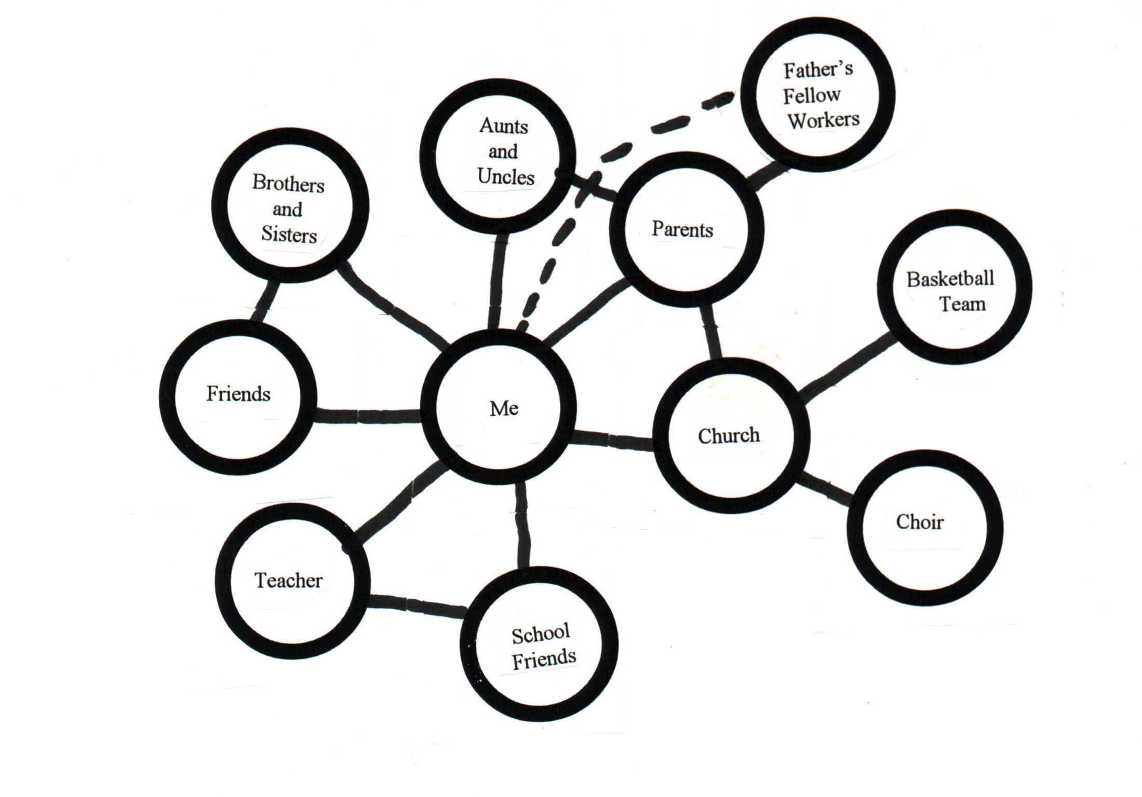

Slide 14
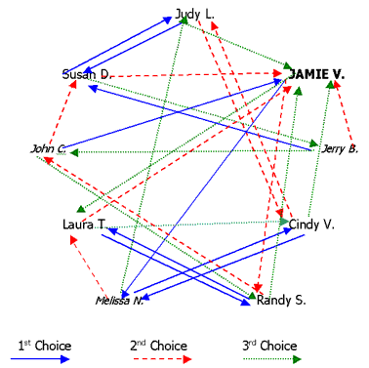

Slide 15
Theoretical sampling – Researcher seeks a sample in order to test a specific hypothesis.
  Drawn from theory
A type of purposive sampling
A staple of grounded theory
Sampling is fluid

Slide 16
Self-selection sampling – test yourself
Often used in sensation/perception experiments
Problems
  Lacks diversity
  Can be extremely biased

Slide 17
Repeat sampling methods – studying changes over time.
Repeat survey - entire survey process is repeated, including the sampling.
  Sample is randomly selected.
E.g., voter preferences leading up to election
Problems: must have large sample to make generalizations over time.
Random changes in sample may be confused with changes over time.

Slide 18
Panel surveys (aka cohort surveys) - the same sample of people or organizations is contacted several times over a relatively long period.
Longitudinal research
Problem: those associated with longitudinal research (i.e., fatigue, order effects, etc.)

Slide 19
Rotating survey – combination of repeat survey and panel survey.
Sample is changed over repeated measures.
Individuals are only sampled a set number of times.
Helps to eliminate problems with fatigue, order, etc.
  Not perfect in doing so

Slide 20
Dealing with Hidden Populations
Individuals that participate in hidden behavior or organizations.
  Ex., Furries
Must often mix sampling procedures
Snowball sampling a good start – can lead to others
  E.g., deviant case sampling
Issues:
  Confidentiality – many of these groups are hidden for a reason. Provide anonymity
  Often need to get their confidence

